Slide 1

Quality Control Circle: Endless Innovation
Project Title:
Rectification of primary dust catcher (PDC) cooling pipes
JSW Steel Ltd, Dolvi
https://1drv.ms/p/c/096c43f5cc6632e3/EQJzfiv8jA5BhPR8O015DmABzDLOliAucV1AK9GIJMLf0A

Slide 2
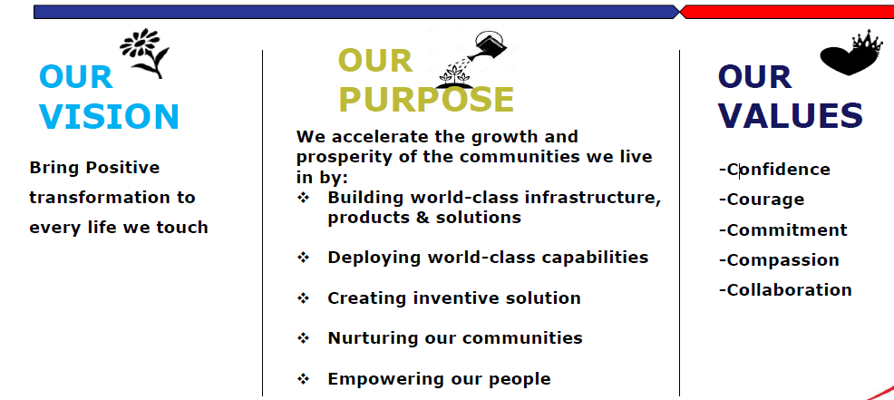
The flagship company of JSW Group, JSW Steel is one of India’s leading integrated
steel manufacturers with a capacity of 18 million tons per annum(MTPA).
By 2025, JSW Steel aims to produce 40 MTPA.
JSW Steel Ltd, Dolvi

Slide 3
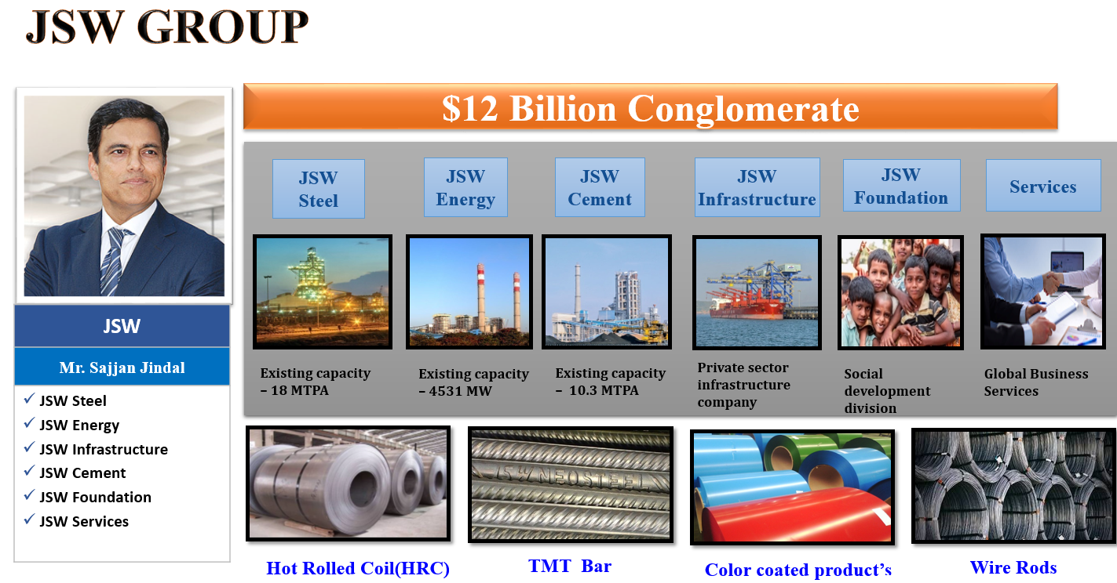
JSW Steel Ltd, Dolvi

Slide 4


Quality Circle Team Charter
TIC | Coke Oven & Refractory | HOD | Mr. Sanjay V. Gurme
Department | Coke Oven II | Day & Time of meeting | Every Saturday
Section/ Area | CDQ2&3 | No. of Problems Identified | 37
Date of Formation |  | Problems Solved | 1
Registration No: | QCPR/FY2023-2024/QCC/Coke Oven & Refractory/Coke Oven-2/58/838 | Team Details:
 |  | Leader | Mr. Sagar Kumar Singh
Name of QC Circle | ENDLESS INNOVATION | Member 1 | Mr. Sumant kumar
 |  | Member 2 | Mr. Bishwajeet Singh
 |  | Member 3 | Mr. Mukul Kumar
Facilitator | Mr. Shreyan Koshti | Member 4 | Mr.Sonu Ansari
Process Owner | Mr. D.B. Varaprasad
JSW Steel Ltd, Dolvi

Slide 5
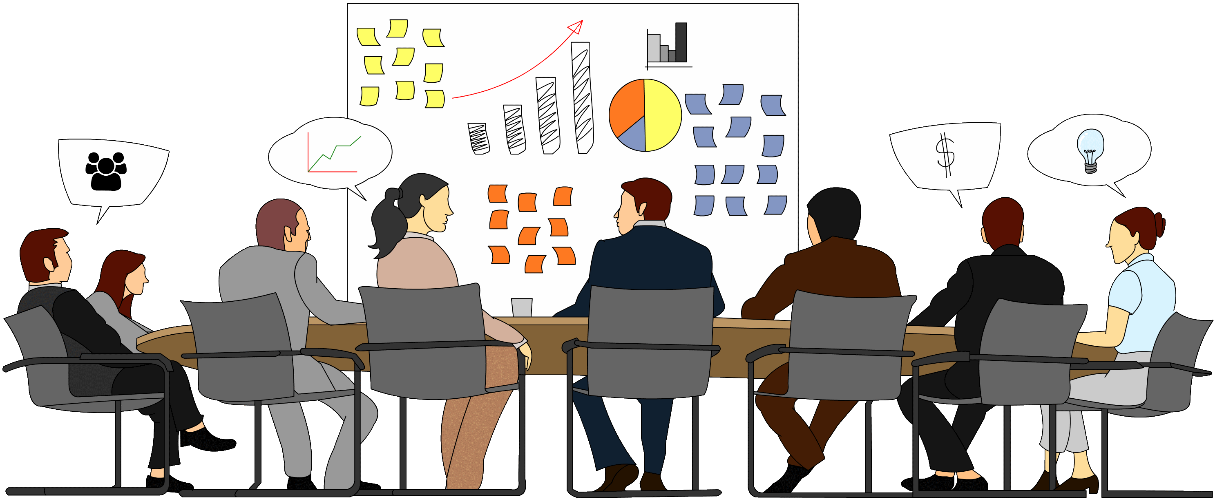
STEP - 1
IDENTIFICATION OF PROBLEMS
Technique used : Brain Storming
JSW Steel Ltd, Dolvi

Slide 6
Step 1 Identification of Problem
PROBLEM IDENTIFICATION BANK
Sl. No. | PROBLEM | Sl. No. | PROBLEM | Sl. No. | PROBLEM
1 | RSV Trip for Liner | 16 | Loco Bucket indication problem | 31 | Gas Circulation Fan Drive issue
2 | Nitrogen Consumption High than Design | 17 | APS Indication problem | 32 | ID fan drive issue
3 | GCF Tripping for Low IA | 18 | Crane operation frequent stoppage for APS Signal issue | 33 | Gas Analyzer problem
4 | GDS vibrator not working | 19 | RSV Dust generation from Vibrofeeder | 34 | Frequently steam line leakages and steam trap failure
5 | GDS hopper level sensor not working | 20 | Water seal pump failure | 35 | Bucket Rotation Problem.
6 | GCF Inlet Damper not working | 21 | Bucket Elevator tripping issue | 36 | water seal pot pump trip issue
7 | Chamber slide gate not working | 22 | PDC SDC RAV jamming | 37 | LOCO bucket present indication issue
8 | PDC SDC level sensor not working | 23 | PDC Cooling pipe leakage
9 | Charging Hopper Alignment issue in Chamber | 24 | Radar sensor Malfunctioning
10 | Frequent conveyor stop resulting loss of Production | 25 | GDS Bag filter damaged
11 | Frequent Bucket Liner damage | 26 | GDS Discharge cylinder Issue
12 | Bucket Swapping takes time for unavailability of Carriage | 27 | Flow Chain conveyor trip issue for sensor failure
13 | Coke Conveyor Spillage | 28 | Seal pot jamming issue with Dust
14 | Frequent jamming of GDS Hopper | 29 | Visibility issue of Operator from Cabin
15 | Frequent jamming of Pugmill | 30 | Charging crane drive fault
JSW Steel Ltd, Dolvi

Slide 7

STEP - 2
Selection of Problem
Tool used: Stratification and Bar graph
JSW Steel Ltd, Dolvi

Slide 8

Step 2 Selection of Problem
PROBLEM IDENTIFICATION BANK(A/B/C)
Sl. No. | PROBLEM | PRIORITY |  |  | Sl. No. | PROBLEM | PRIORITY
1 | RSV Trip for Liner | A |  |  | 16 | Loco Bucket indication problem |  | B
2 | Nitrogen Consumption High than Design | A |  |  | 17 | APS Indication problem |  | B
3 | GCF Tripping for Low IA |  | B |  | 18 | Crane operation frequent stoppage for APS Signal issue |  | B
4 | GDS vibrator not working | A |  |  | 19 | RSV Dust generation from Vibrofeeder | A
5 | GDS hopper level sensor not working | A |  |  | 20 | Water seal pump failure | A
6 | GCF Inlet Damper not working | A |  |  | 21 | Bucket Elevator tripping issue | A
7 | Chamber slide gate not working |  |  | C | 22 | PDC SDC RAV jamming | A
8 | PDC SDC level sensor not working | A |  |  | 23 | PDC Cooling pipe leakage |  |  | C
9 | Charging Hopper Alignment issue in Chamber | A |  |  | 24 | Radar sensor Malfunctioning | A
10 | Frequent conveyor stop resulting loss of Production |  | B |  | 25 | GDS Bag filter damaged | A
11 | Frequent Bucket Liner damage |  | B |  | 26 | GDS Discharge cylinder Issue | A
12 | Bucket Swapping takes time for unavailability of Carriage |  |  | C | 27 | Flow Chain conveyor trip issue for sensor failure | A
13 | Coke Conveyor Spillage | A |  |  | 28 | Seal pot jamming issue with Dust | A
14 | Frequent jamming of GDS Hopper | A |  |  | 29 | Visibility issue of Operator from Cabin |  | B
15 | Frequent jamming of Pug mill | A |  |  | 30 | Charging crane drive fault | A
JSW Steel Ltd, Dolvi
JSW Steel Ltd, Dolvi
12

Slide 9
Step 2 selection of Problem
PROBLEM IDENTIFICATION BANK(A/B/C)
Sl. No. | PROBLEM | PRIORITY
31 | Gas Circulation Fan Drive Fault | A
32 | ID fan drive Fault | A
33 | Gas Analyzer problem |  | B
34 | Frequently steam line leakages and steam trap failure |  | B
35 | Bucket Rotation Problem. | A
36 | water seal pot pump trip issue | A
37 | LOCO bucket present indication issue | A
Complexity:
A: Within Department
B: Cross Functional
C: Management Support
JSW Steel Ltd, Dolvi
13

Slide 10
Step 2 selection of Problem
BRAINSTROMING (A/B/C Analysis)
Complexity | No. of Problems
A CATEGORY | 25
B CATEGORY | 9
C CATEGORY | 3
A- Within department
B- Cross functional
C- Management support
JSW Steel Ltd, Dolvi
JSW Steel Ltd, Dolvi

Slide 11
Step 2 selection of Problem
BRAINSTROMING (A/B/C Analysis)
Sl. No. | LIST OF PROBLEM | Category A | QC /Kaizen | Sl. No. | LIST OF PROBLEM | Category A | QC /Kaizen
1 | RSV Trip for Liner | A | QC | 15 | Radar sensor Malfunctioning | A | QC
2 | Nitrogen Consumption High than Design | A | QC | 16 | GDS Bag filter damaged | A | Kaizen
3 | GDS vibrator not working | A | Kaizen | 17 | GDS Discharge cylinder Issue | A | QC
4 | GDS hopper level sensor not working | A | Kaizen | 18 | Flow Chain conveyor trip issue for sensor failure | A | Kaizen
5 | GCF Inlet Damper not working | A | Kaizen | 19 | Seal pot jamming issue with Dust | A | Kaizen
6 | PDC SDC level sensor not working | A | Kaizen | 20 | Charging crane drive fault | A | QC
7 | Charging Hopper Alignment issue in Chamber | A | Kaizen | 21 | Gas Circulation Fan Drive Fault | A | Kaizen
8 | Coke Conveyor Spillage | A | Kaizen | 22 | ID fan drive Fault | A | Kaizen
9 | Frequent jamming of GDS Hopper | A | Kaizen | 23 | Bucket Rotation Problem. | A | QC
10 | PDC Cooling pipe leakage | A | QC | 24 | water seal pot pump trip issue | A | Kaizen
11 | RSV Dust generation from Vibrofeeder | A | Kaizen | 25 | LOCO bucket present indication issue | A | Kaizen
12 | Water seal pump failure | A | Kaizen |  |  | A
13 | Bucket Elevator tripping issue | A | Kaizen |  |  | A
14 | PDC SDC RAV jamming | A | Kaizen |  |  | A
JSW Steel Ltd, Dolvi
JSW Steel Ltd, Dolvi

Slide 12
Step 2 Selection of Problem
BRAINSTROMING (A/B/C Analysis)
Sl.no. | LIST OF PROBLEM | Category A | QC /Kaizen | IMPACT
 |  |  |  | P | Q | C | D | M | E | S
1 | RSV Trip for Liner | A | QC | P | Q | C |  |  |  | S
2 | Nitrogen Consumption High than Design | A | QC |  | Q | C
10 | PDC Cooling pipe leakage | A | QC | P |  | C | D |  | E | S
15 | Radar sensor Malfunctioning | A | QC | P |  |  |  |  |  | S
17 | GDS discharge cylinder issue | A | QC |  | Q |  | D | M | E
20 | Charging crane drive fault | A | QC | P |  |  |  | M
23 | Bucket Rotation Problem. | A | QC
JSW Steel Ltd, Dolvi
16

Slide 13
Step 2 Selection of Problem
PROBLEM IMPACT ANALYSIS
Impact | QCC
Productivity (P) | 4
Quality (Q) | 3
Cost (C) | 3
Delivery (D) | 2
Morale (M) | 2
Environment (E) | 1
Safety (S) | 3
2
JSW Steel Ltd, Dolvi

Slide 14
Selection of the Problem
BRAINSTROMING (A/B/C Analysis)
LEVEL OF IMPACT
WEAK = 2 MEDIUM = 5 STRONG = 10
Sr. No. | Problem | Productivity | Quality | Cost | Delivery | Safety | Morale | Environment | Total
1 | RSV Trip due to liner |  |  |  |  |  |  |  | 28
2 | Nitrogen consumption is high than design |  |  |  |  |  |  |  | 28
3 | PDC Cooling pipe leakage |  |  |  |  |  |  |  | 42
4 | GDS Discharge cylinder Issue |  |  |  |  |  |  |  | 25
5 | Bucket Rotation Problem. |  |  |  |  |  |  |  | 23
JSW Steel Ltd, Dolvi
THEME SELECTED :- Quality

Slide 15
Step 2 Selection of Problem
PRIORITIZATION OF PROBLEMS(RATING METHOD)
Sl. No. | List of Problems | FACILITATOR | LEADER | MEMBERS
 |  | Shreyan | Sagar | Sumant | Biswajeet | Mukul | Sonu | Total
01 | RSV trip for liner | 8 | 7 | 7 | 8 | 5 | 6 | 41
02 | Nitrogen consumption high than design | 8 | 7 | 6 | 7 | 6 | 5 | 39
03 | PDC Cooling pipe leakage | 9 | 8 | 8 | 9 | 8 | 8 | 50
03 | GDS discharge cylinder issue | 7 | 8 | 6 | 8 | 4 | 5 | 38
05 | Bucket rotation problem. | 8 | 6 | 6 | 6 | 5 | 6 | 37
MARKS CRITERIA
LEAST | 0-3
MODERATE | 4-7
HIGH | 7-10
JSW Steel Ltd, Dolvi

Slide 16
Step 2 Selection of Problem
PRIORITIZATION OF PROBLEMS ANALYSIS
JSW Steel Ltd, Dolvi

Slide 17

Step 2 Selection of Problem
PROBLEM SELECTED
Primary dust catcher (PDC) cooling pipe leakage
JSW Steel Ltd, Dolvi

Slide 18
MILESTONE CHART
Sr. No | STEPS | P/A | Dec |  |  |  | Jan
 |  |  | W1 | W2 | W3 | W4 | W1 | W2 | W3 | W4
1 | Define the problem | Plan
 |  | Actual
2 | Analysis of problem | Plan
 |  | Actual
3 | Identification of causes | Plan
 |  | Actual
4 | Identification of root causes | Plan
 |  | Actual
5 | Data analysis | Plan
 |  | Actual
6 | Development of solution | Plan
 |  | Actual
7 | Foreseen resistance | Plan
 |  | Actual
8 | Trial Implementation | Plan
 |  | Actual
9 | Regular Implementation | Plan
 |  | Actual
10 | Follow up/Review | Plan
 |  | Actual

Slide 19
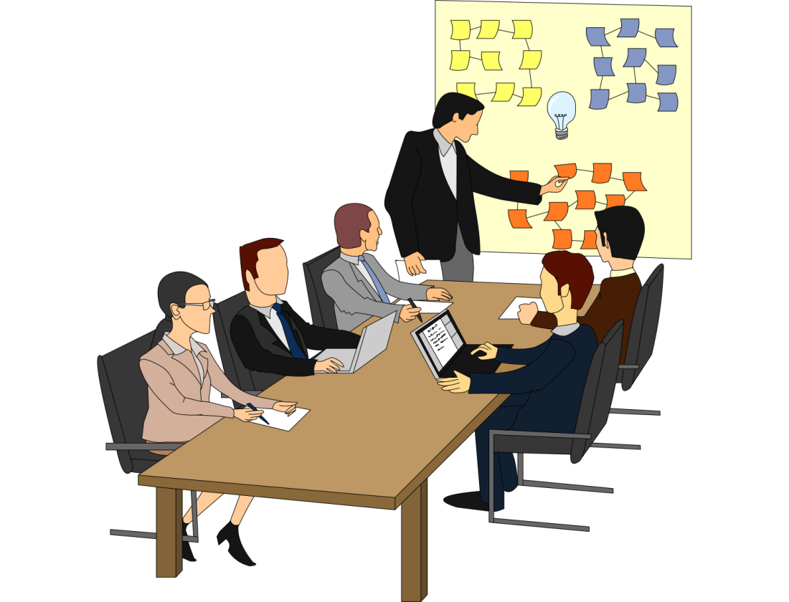
STEP - 3
DEFINE THE PROBLEMS
Tool used: Diagram
JSW Steel Ltd, Dolvi

Slide 20
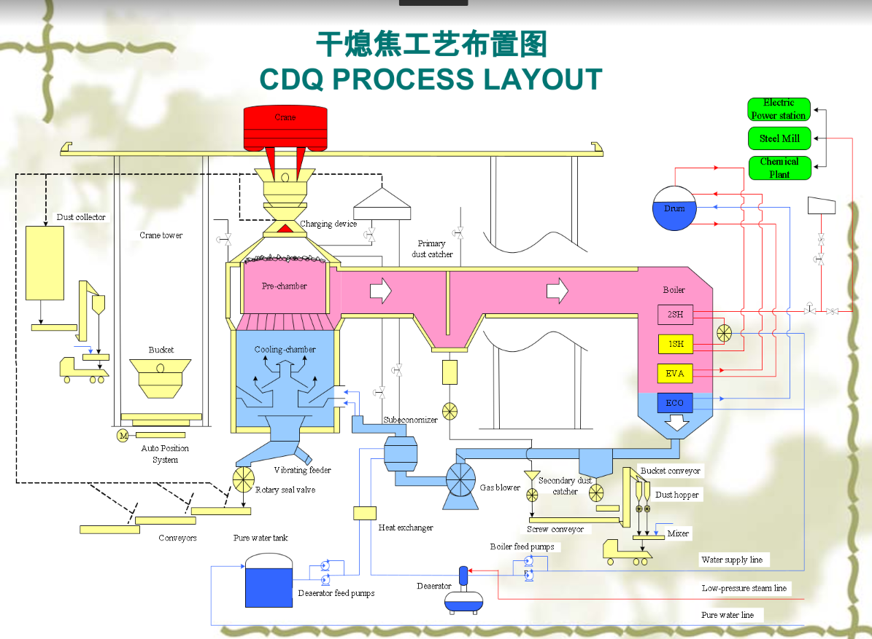
COKE DRY QUENCHING-HIGH LEVEL DIAGRAM
JSW Steel Ltd, Dolvi

Slide 21
Step 3 Define the Problem
DEFINE THE PROBLEM
PROBLEM STATEMENT- The problem lies in punctured PDC cooling pipes, which compromise the chain conveyor's health, lead to rust formation, and cause dust buildup in PDC hoppers. This, in turn, elevates boiler inlet pressure and exacerbates dust generation, deviating from design specifications. Rectifying or preventing these punctures is crucial for maintaining system efficiency and performance.
Dust generation as per design,
Preventing PDC cooling pipe punctures which compromise the chain conveyor's health, rust cooling pipes, and to reduce boiler inlet pressure
Objective
Goal
Dust generation -1380 tons to 1640 tons/months &
Boiler inlet pressure -1.21kpa to -0.78kpa
Duration
10/03/2024 to 11/05/2024 (2 months)
JSW Steel Ltd, Dolvi

Slide 22

STEP-3: DEFINE THE PROBLEM
IMPACT OF THE PROBLEM
Thermal variations may cause the cooling pipe puncture in the primary duct catcher, leading to welding fractures that affect the chain conveyor's health
Corrosion of cooling pipes
Dust accumulation inside PDC hoppers, which increases boiler inlet pressure.
Adverse effect on chain conveyor's life & high maintenance cost
JSW Steel Ltd, Dolvi

Slide 23

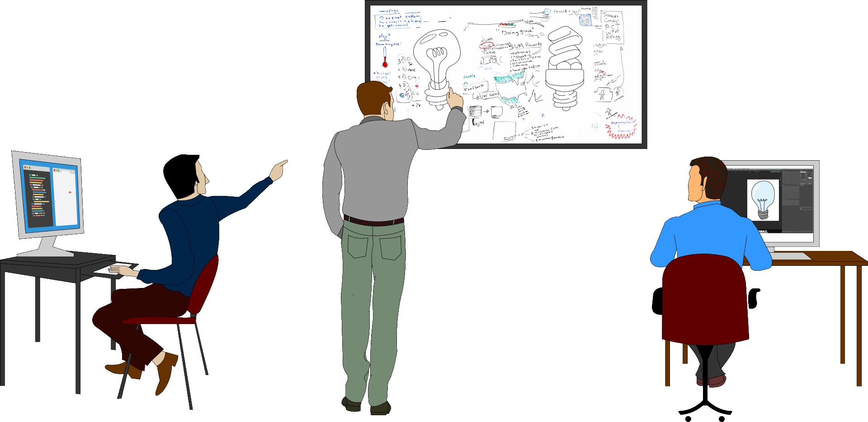
STEP - 4
ANALYZE THE PROBLEMS
Tools & technique used : Check sheet, graph,4W1h analysis
JSW Steel Ltd, Dolvi

Slide 24

Step 4 Analyse the problem
4W-1H ANALYSIS
WHAT | WHERE | WHEN | WHO | HOW MUCH
Dust Generation | CDQ Primary Dust Catcher | During Continuous Operation of CDQ | CDQ Operation | 1380tons to 1640 tons/month
Boiler Inlet Pressure (P6) | CDQ Primary Dust Catcher | During Continuous Operation of CDQ | CDQ Operation | -1.21kpa to -0.78kpa
JSW Steel Ltd, Dolvi

Slide 25
Step 4 Analyse the problem
DATA BASE- BEFORE

Slide 26
Step 4 Analyse the problem
DATA BASE- BEFORE
JSW Steel Ltd, Dolvi

Slide 27
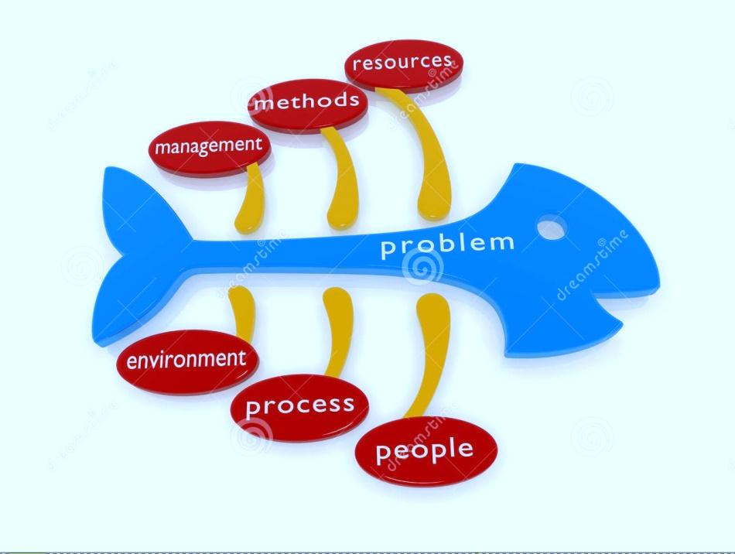
STEP - 5 IDENTIFY CAUSES
Tools : Cause and Effect diagram
JSW Steel Ltd, Dolvi

Slide 28
Step 5 Identify the causes
LIST OF CAUSES
Sr.No | Causes
1 | Hot dust accumulation inside cooling pipes for longer duration
2 | Excess discharge through hoppers
3 | Insufficient flow of cooling water inside jacket
4 | Cooling water quality affects on pipes (like corrosion)
5 | Frequent SDC PDC chain conveyor breakdown
6 | Chamber silos RAV issue like jamming, resulting in chain conveyors stoppage
7 | PDC nitrogen valve jam
8 | Cooling pipes chocking by refractory material
9 | Hammering effect in conical portion
10 | Dust jamming issue
11 | Coke jamming(coke floating) issue (coke stucking inside pipes)
JSW Steel Ltd, Dolvi

Slide 29
Step 5 Identify the causes
CAUSE & EFFECT DIAGRAM
Man
Hammering effect in conical portion
Machine
Conveyor maintenance
Excess discharge through hoppers
Frequent SDC PDC chain conveyor breakdown
Cooling water pipe leakage
Cooling water quality affects on pipes (like corrosion)
Coke jamming(coke floating) issue
Interlock timing of dust discharge
Cooling pipes chocking by refractory material
Hot dust accumulation inside cooling pipes for longer duration
Dust jamming issue
Material
Method
JSW Steel Ltd, Dolvi

Slide 30
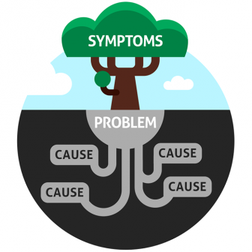
STEP - 6 IDENTIFY ROOT CAUSES
Tools & technique used : Fish bone and why -why analysis
JSW Steel Ltd, Dolvi

Slide 31
Step 6 Identify root causes
LIST OF ROOT CAUSES
Sr.NO | PROBABLE ROOT CAUSES
1 | Hot dust accumulation inside cooling pipes for longer duration
2 | Excess discharge through hoppers
3 | Cooling water quality affects on pipes (like corrosion)
4 | Cooling pipes chocking by refractory material
5 | Coke jamming(coke floating) issue (coke stucking inside pipes)
JSW Steel Ltd, Dolvi

Slide 32
Step 6 Identify root causes
VALIDATATION OF ROOT CAUSES
Sr.No | ROOT CAUSE | OBSERVATION | VALID/INVALID
1 | Hot dust accumulation inside cooling pipes for longer duration | Increase in TT(Temperature transmitter) | VALID
2 | Excess discharge through hoppers | Physical observation | VALID
3 | Cooling water quality affects on pipes (like corrosion) | Cleaning done | VALID
4 | Cooling pipes chocking by refractory material | Physical observation | VALID
5 | Coke jamming(coke floating) issue (coke stucking inside pipes) | Physical observation | VALID
6 | PDC nitrogen valve jam | Physical observation | INVALID
JSW Steel Ltd, Dolvi

Slide 33

Step 6 Identify root causes
CONFIRMED VALID ROOT CAUSES
Sr.No | VALID ROOT CAUSES
1 | Hot dust accumulation inside cooling pipes for longer duration
2 | Excess discharge through hoppers
3 | Cooling water quality affects on pipes (like corrosion)
JSW Steel Ltd, Dolvi

Slide 34


Step 7: DATA ANALYSIS
JSW Steel Ltd, Dolvi

Slide 35
Step 7: DATA ANALYSIS
BREAK UP OF VALID ROOT CAUSES
Before Implementation Data

Slide 36
Step 7: DATA ANALYSIS
Before Implementation Data

Slide 37


STEP 8: DEVELOPING SOLUTIONS
Through Brain Storming
JSW Steel Ltd, Dolvi

Slide 38
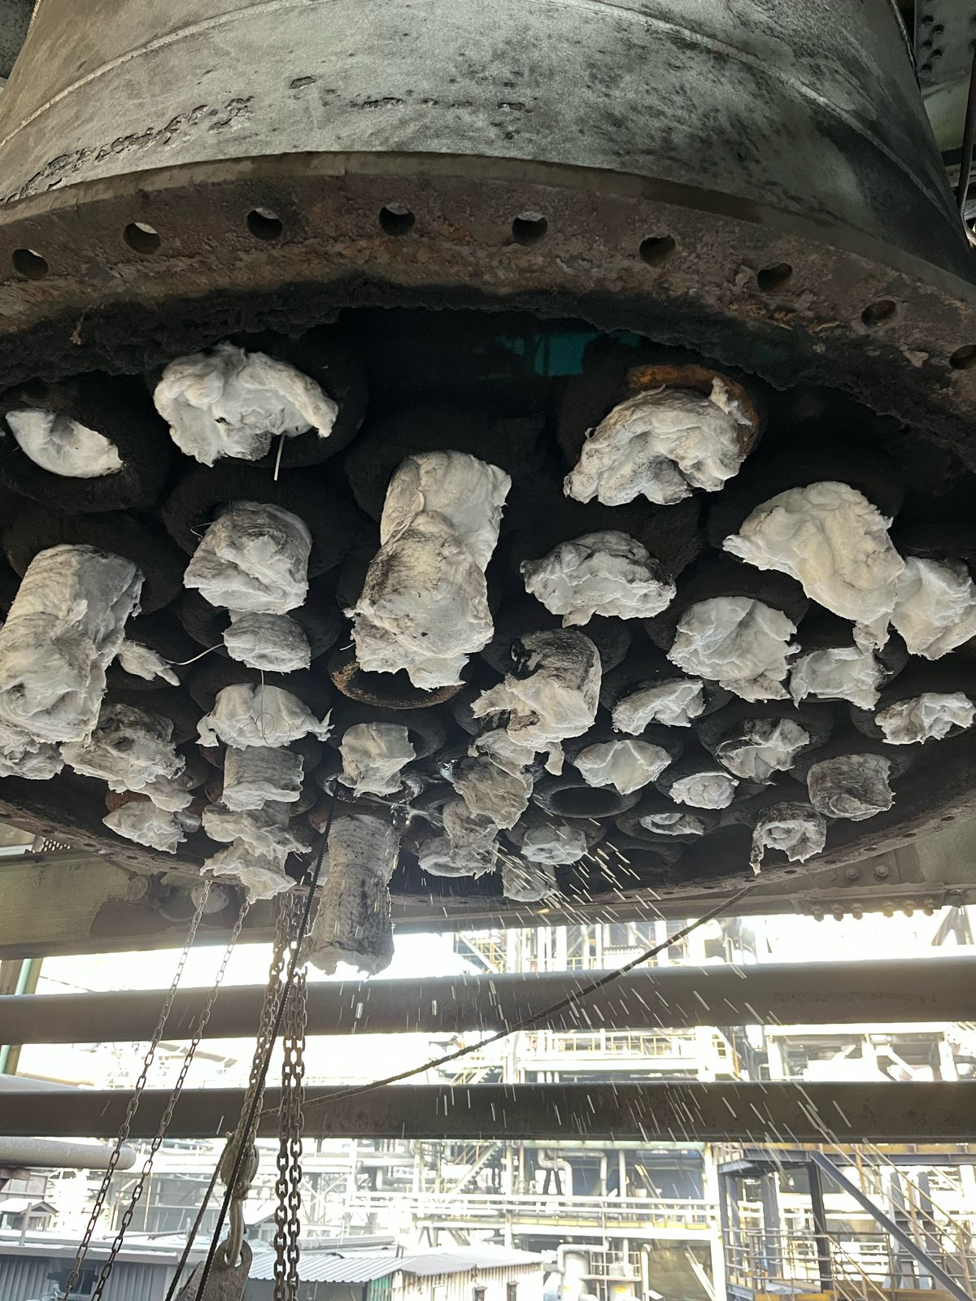
PROPOSED SOLUTION
Description of solution to cause:
We discovered this issue when water leakage from the PDC cooling pipe began to leak, causing damage to the chain conveyor linkage and affecting the life span of the chain conveyor, so during shutdown time, we opened the conical portion of the PDC 2 hopper and checked and which need to be arrest leakage tubes.
Identified but it should be arrest punctured cooling pipe asap

Slide 39
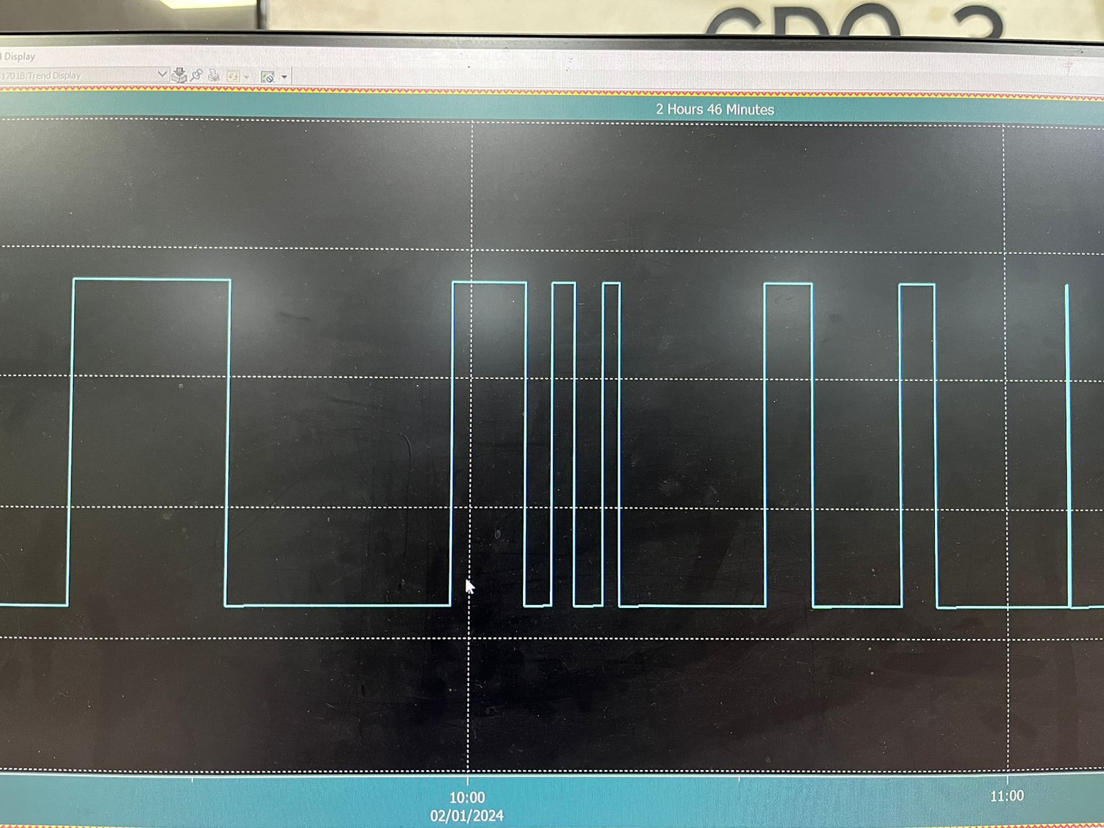
PROPOSED SOLUTION
Description of solution to cause: Hot dust accumulation inside cooling pipes for longer duration & Excess discharge through hoppers
To prevent hot dust accumulation inside cooling pipes for longer durations and excess discharge through hoppers, we can change discharge technique from manual to efficient technique of adding a timer to discharge so that dust will come in proper time and will not increase the temperature of dust.
Dust discharging trend (manually)Before

Slide 40
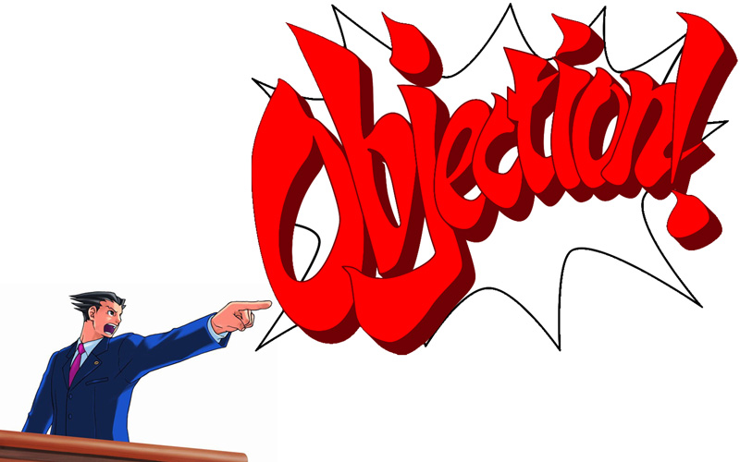
STEP 9: FORSEEING PROBABLE RESISTANCES
JSW Steel Ltd, Dolvi

Slide 41
STEP 9: FORSEEING PROBABLE RESISTANCES
Sr no | Queries | Raised by | Answer given by QC members
1 | How much time is required to arrest puncture will it be increase dust generation and boiler inlet pressure | Mr. Varaprasad (Operation) | Will isolate the line and check the abnormalities and arresting will be completed by 5-6 hrs and surely it will increases dust generation and other parameters
2 | How far is it feasible ? | Mr.Gopinath (Mechanical) | It is 100 % feasible because the parameters will be in control as monitored for whole day
3 | What about Safety? | Mr. Darshan Dave (Safety) | All Solution are safe and easy to Operate
4 | What about the cost? | Arun Kumar (Electrical) | No additional cost done with available materials
JSW Steel Ltd, Dolvi

Slide 42


STEP 10: TRIAL IMPLIMENTATION
JSW Steel Ltd, Dolvi

Slide 43
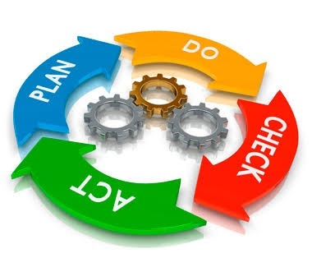
DEMING CYCLE
Problem is selected and Impacts of the problem are quantified
Two root causes are identified & validated based on experience & observation
And for which solutions are developed.
SOP has been modified accordingly
Outcome of which is found to be very effective.
Proposed solutions are implemented & results are checked

Slide 44
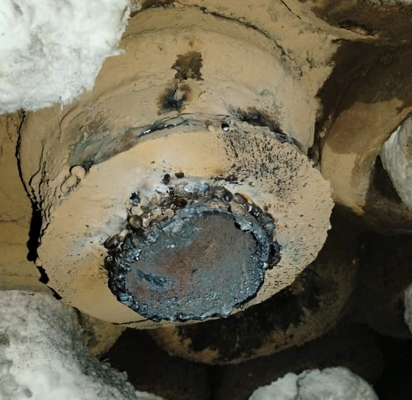
Description of solution to cause:
We discovered this issue when water leakage from the PDC cooling pipe began to leak, causing damage to the chain conveyor linkage and affecting the life span of the chain conveyor, so during shutdown time, we opened the conical portion of the PDC 2 hopper and checked and arrested the leakage tubes.
Identified and arrested punctured cooling pipe

Slide 45
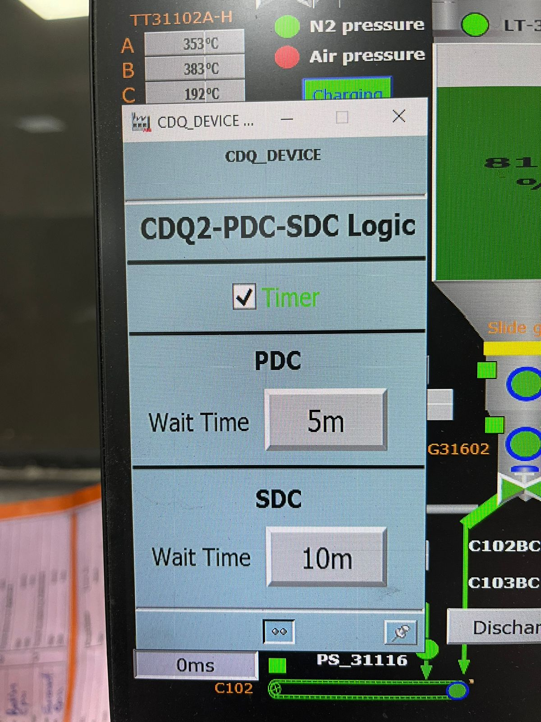
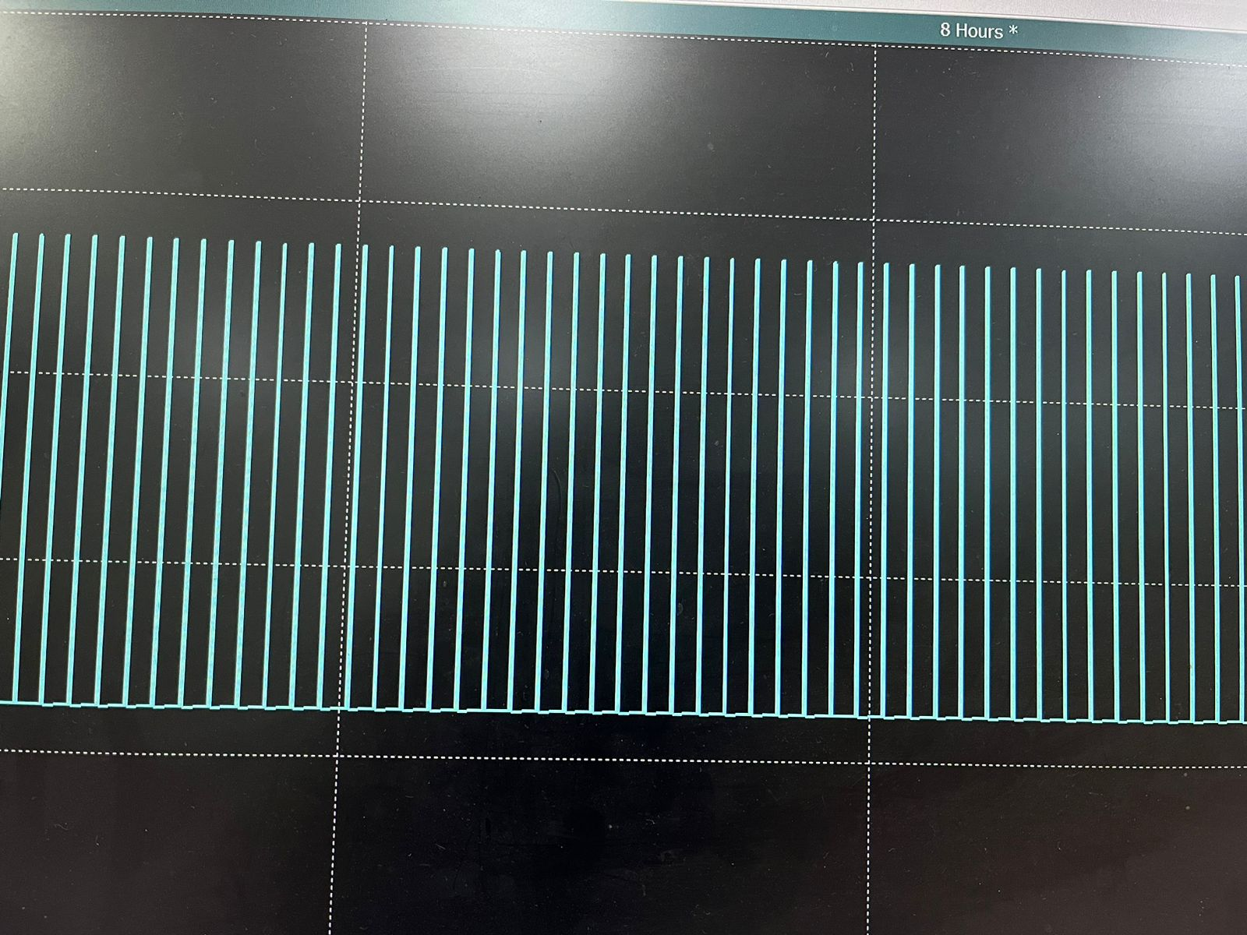
Description of solution to cause: Hot dust accumulation inside cooling pipes for longer duration & Excess discharge through hoppers
To prevent hot dust accumulation inside cooling pipes for longer durations and excess discharge through hoppers, we can change discharge technique from manual to efficient technique of adding a timer to discharge so that dust will come in proper time and will not increase the temperature of dust.
Dust discharging trend (manually)Before
Timer implementation
Uniform Discharge accordingly timer

Slide 46
BEFORE – AFTER COMPARISON
Dust generation data from OCT 2023 –Feb 2024
Boiler inlet pressure data from OCT 2023 –Feb 2024
JSW Steel Ltd, Dolvi

Slide 47
BEFORE – AFTER COMPARISON
JSW Steel Ltd, Dolvi

Slide 48


STEP 11: REGULER IMPLEMENTATION
JSW Steel Ltd, Dolvi

Slide 49
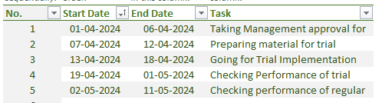
GANTT CHART
JSW Steel Ltd, Dolvi

Slide 50
TANGIBLE AND INTAGIBLE BENEFITS
Tangible Benefits | Intangible Benefits
1) Dust generation cost (monthly)=260 Tons * Dust cost per ton | 1) Equipment Healthiness
2) Dust discharge time gets reduced to half the before, so equipment healthiness is beneficial | 2) Easy manpower handling
3)5 Housekeeping manpower cost for manually dust removal | 3) Less anxiety when it comes to periodically manually discharge
JSW Steel Ltd, Dolvi

Slide 51


FOLLOW-UP/REVIEW AND
RECURRENCE PREVENTION
SMP reviewed again to have a better results
SOP provided incase of external discharge
Training given to operators for the procedure
Checklist provided in control room for monitoring discharge
JSW Steel Ltd, Dolvi

Slide 52
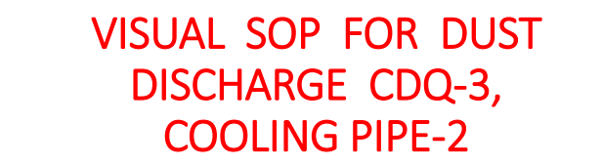
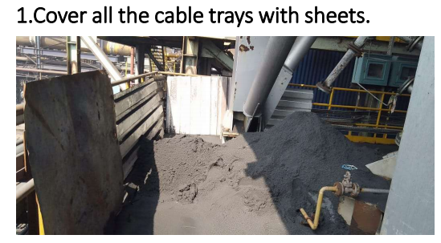
FOLLOW-UP/REVIEW AND
RECURRENCE PREVENTION
JSW Steel Ltd, Dolvi

Slide 53
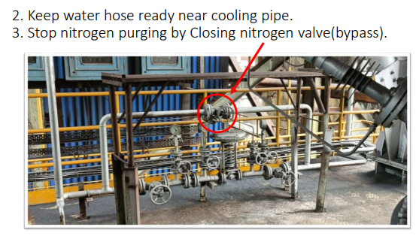
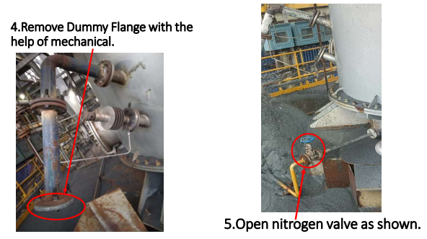
FOLLOW-UP/REVIEW AND
RECURRENCE PREVENTION
JSW Steel Ltd, Dolvi

Slide 54
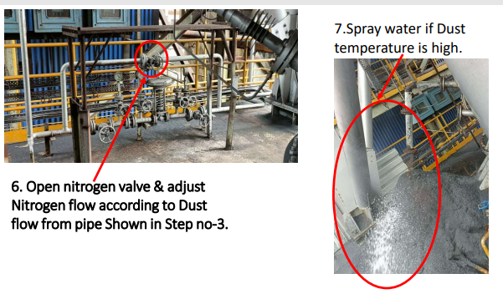
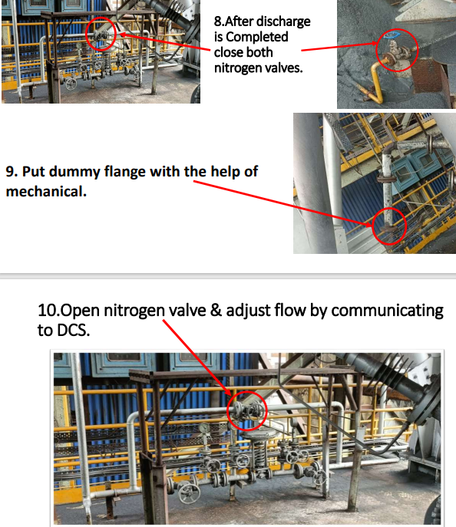
FOLLOW-UP/REVIEW AND
RECURRENCE PREVENTION
JSW Steel Ltd, Dolvi

Slide 55
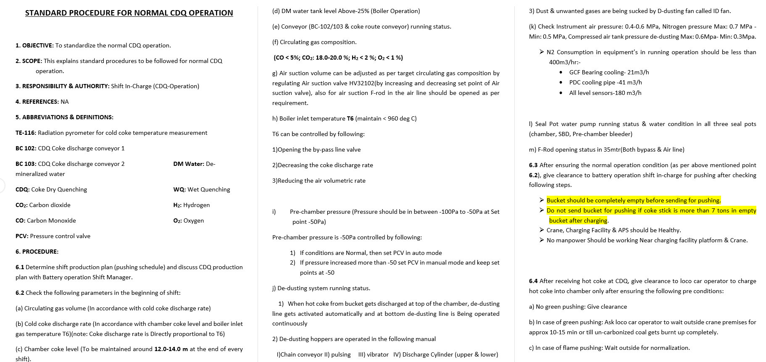
FOLLOW-UP/REVIEW AND
RECURRENCE PREVENTION
JSW Steel Ltd, Dolvi

Slide 56
PROJECT COMPLETION SHEET
JSW Steel Ltd, Dolvi

Slide 57
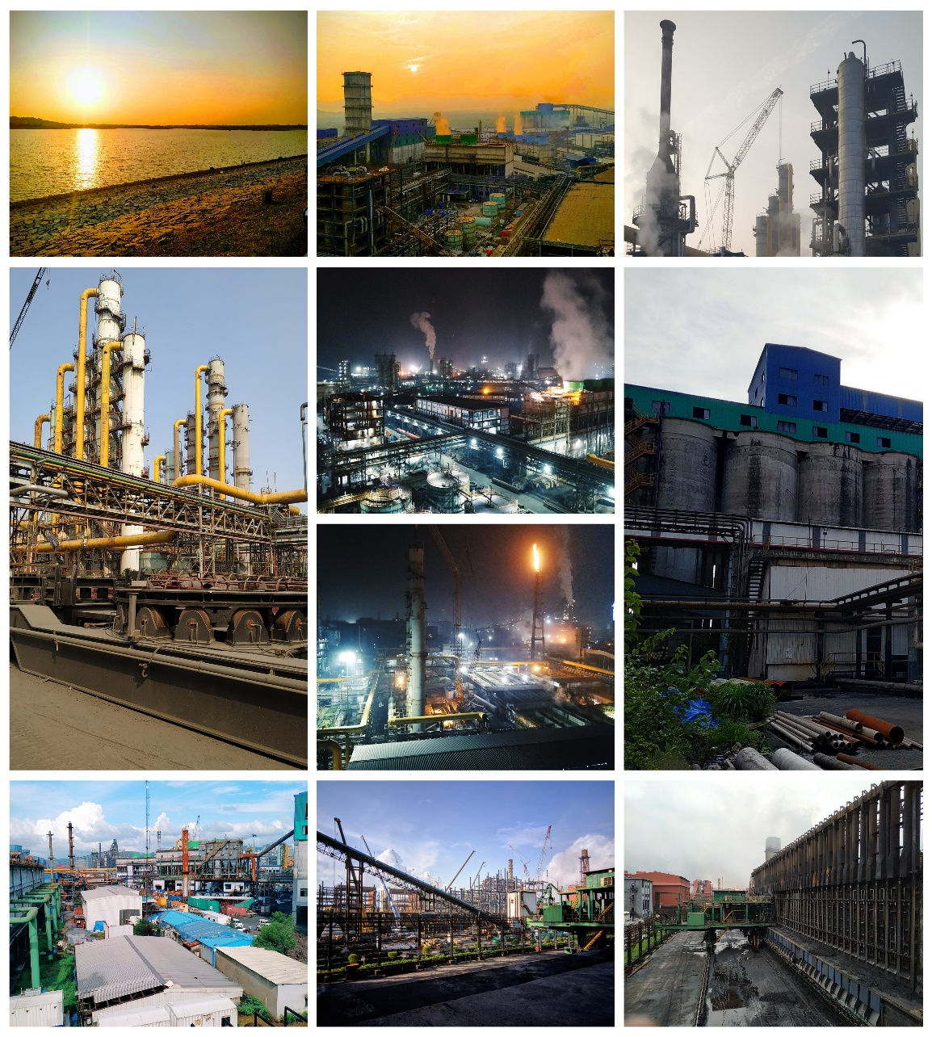
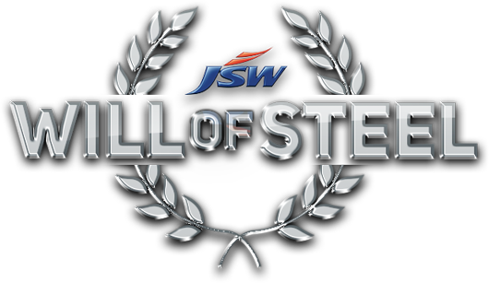

JSW Steel Ltd, Dolvi

